Slide 1
DeFECT TRACKING SYSTEM
Mini project By
Syed yousuf
Syed parvez
Mohd Sufiyan
Guide Shaik mahboob

Slide 2
overview
Defect tracking system Is a web application which is used by programmers to record the information of bugs which arises during a project development.
This project has an report generation option through which analyzing and work allocation made easy.
This application has made project assignment easy and a project manager can monitor the status of the project.

Slide 3
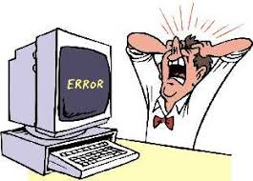
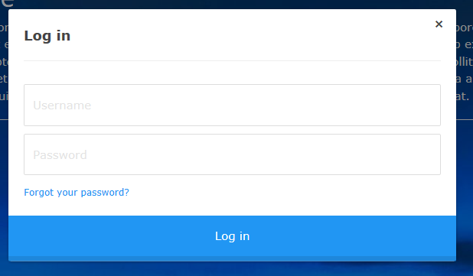
applications
Every employee will be given a unique ID and password through which they need to submit their projects.
Administrator can login and check all the data store in DB.

Slide 4
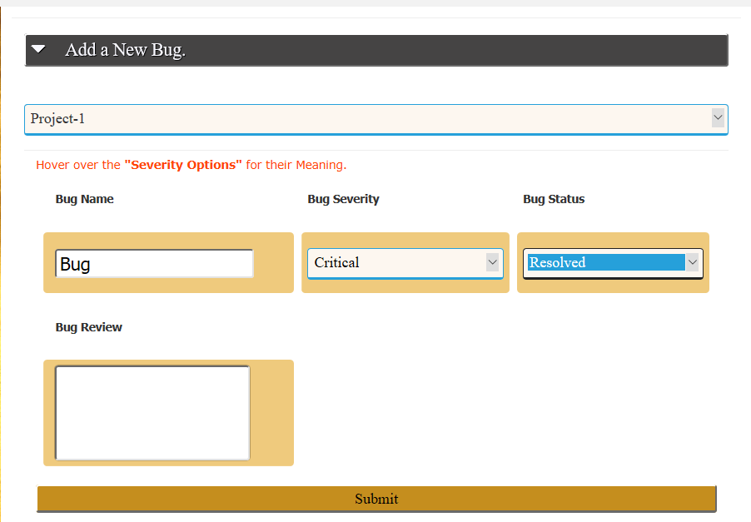
Features & Benefits
Bugs are saved into the database which was found during the execution of the program.
Some Bugs occurs only in the shipping version of the program in this case it can be easily solved by going through the database.

Slide 5
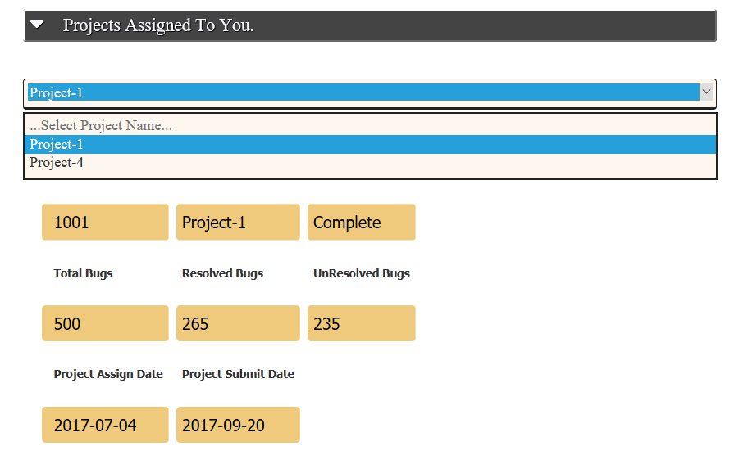
Features & benefits
You can check the project assigned to you.
Its also shows the status of the project and total number of bugs found in that project.

Slide 6
Software requirements
Operating system : Windows xp (least)
User interface : bootstrap, w3css
Back-end : php 5.0
Scripting language : Jquery
Data base : mysql

Slide 7
Hardware requirements
Processor : Pentium 4
Hard disk : 40GB
RAM : 256MB
Internet connection

Slide 8
Proposed system
All the records are maintained in the data base in a structure manner.
It provides a user-friendly environment for the programmers to save the bugs.

Slide 9
Thank
You

